Slide 1
OYO Hotel Booking Analytics REPORT
Date: July 5, 2024
Author: Paras

Slide 2
Contents
Methadology
Case Study & Findings
Objectives
Analysis & Findings
Important Factors
Booking Trends
Revenue Analysis
Hotel Performance
Customer Behaviour
Discount Analysis
Cancellation Analysis

Slide 3

Methadology
The methodology outlines the approach taken to analyze the hotel booking data using MySQL for querying and Tableau for visualization. This involves several steps: data extraction, data processing, analysis, and visualization. quam vehicula

Slide 4
Case Study & Findings
ADD YOUR TEXT
This Case Study Consists of Two Datasets.
The First Dataset consists of Hotel Booking Details of various Customers in Different Cities.
The Second Dataset Contains Hotel Id and The City Where Hotel is Located.
Vestibulum ante ipsum primis in faucibus orciVestibulum ante ipsum
Vestibulum ante ipsum primis in faucibus orciVestibulum ante ipsum
ADD YOUR TEXT
ADD YOUR TEXT
Vestibulum ante ipsum primis in faucibus orciVestibulum ante ipsum
Vestibulum ante ipsum primis in faucibus orciVestibulum ante ipsum

Slide 5
Objective
ADD YOUR TEXT
ADD YOUR TEXT
Vestibulum ante ipsum primis in faucibus orciVestibulum ante ipsum primis in faucibus orci
Vestibulum ante ipsum primis in faucibus orciVestibulum ante ipsum primis in faucibus orci
Analyze the Bookings, Revenue, Performance for the Given Time Period.
Publish the Findings Based on Data Analysis
ADD YOUR TEXT
Vestibulum ante ipsum primis in faucibus orciVestibulum ante ipsum primis in faucibus orci
Vestibulum ante ipsum primis in faucibus orciVestibulum ante ipsum primis in faucibus orci

Slide 6

Analysis & Findings
For Analyzing the Data, Various Factors Affecting the Business (i.e., Bookings, Revenue, Performance, Cancellations, Discounts, Behaviour and Segmentations.

Slide 7
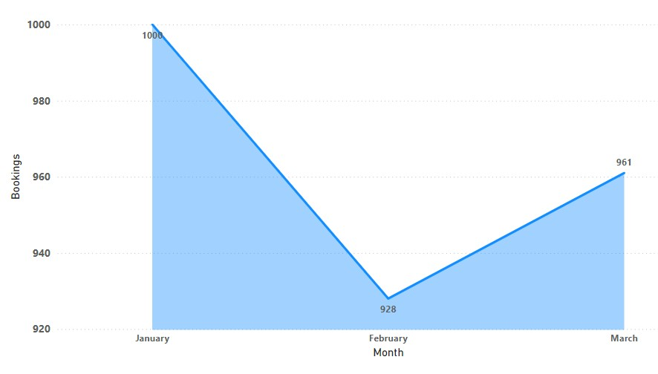
Booking Trends
Bookings Per Month

Slide 8
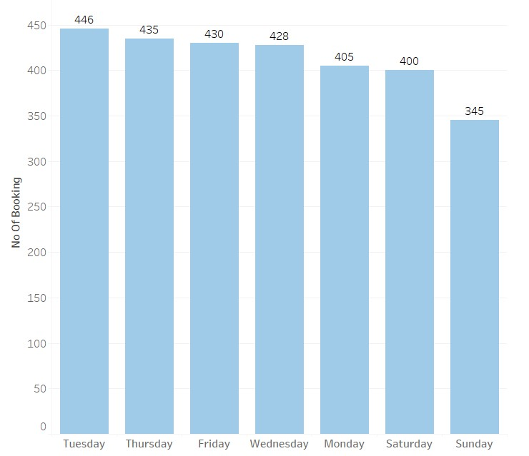
Bookings Per Day
ADD YOUR TEXT
ADD YOUR TEXT
ADD YOUR TEXT

Slide 9
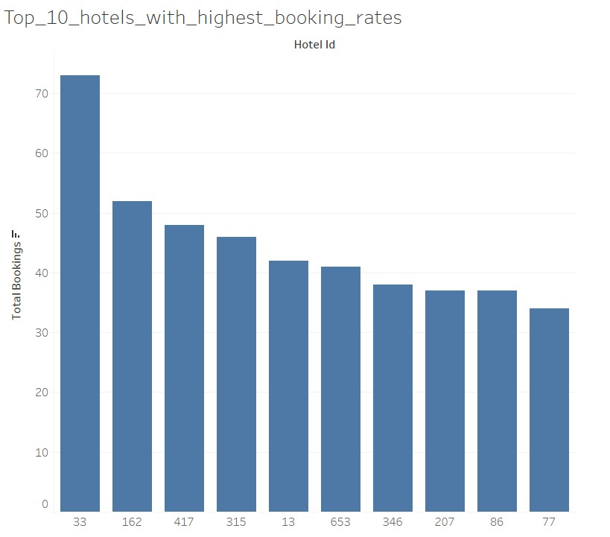

Slide 10
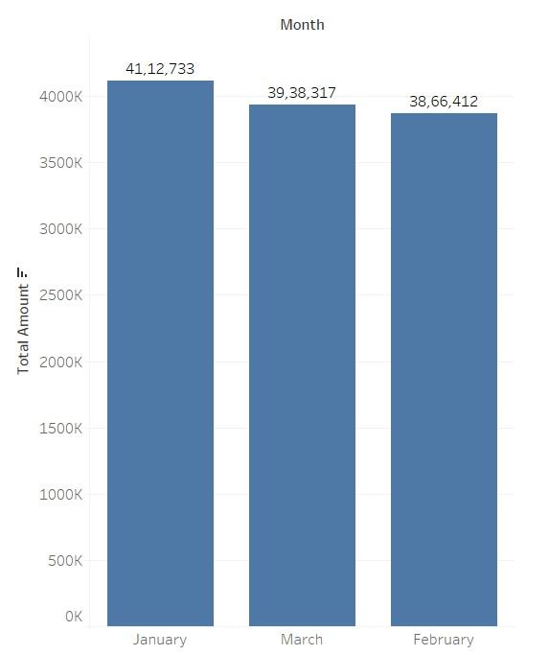
Revenue Analysis
Total Revenue Per Month

Slide 11
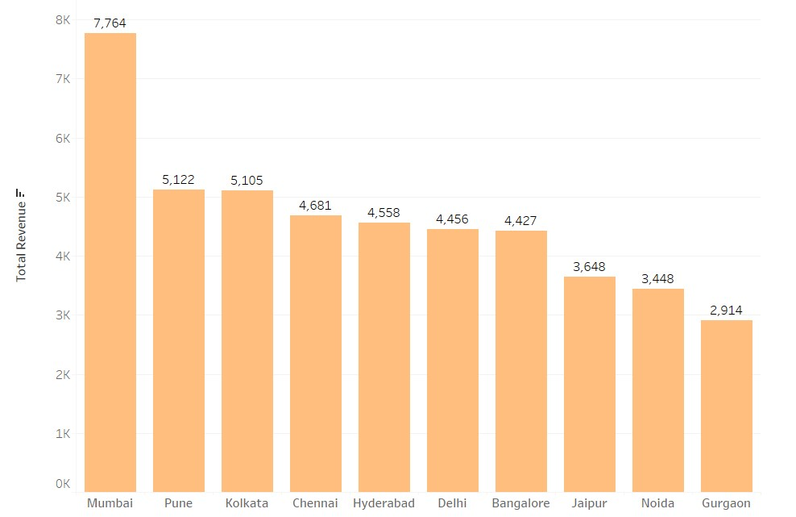
Average Revenue Per City

Slide 12
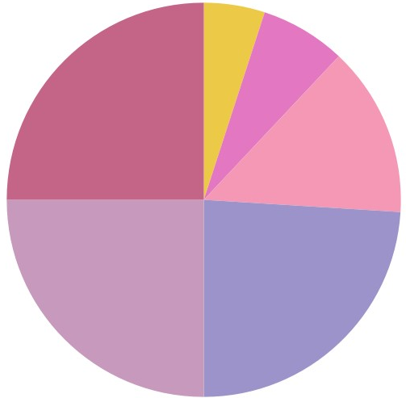
Revenue Percentage Among Top 6 Cities
Hyderabad
Gurgaon
Pune
5 %
7 %
25 %
Mumbai
14 %
25 %
24 %
Delhi
Bangalore

Slide 13
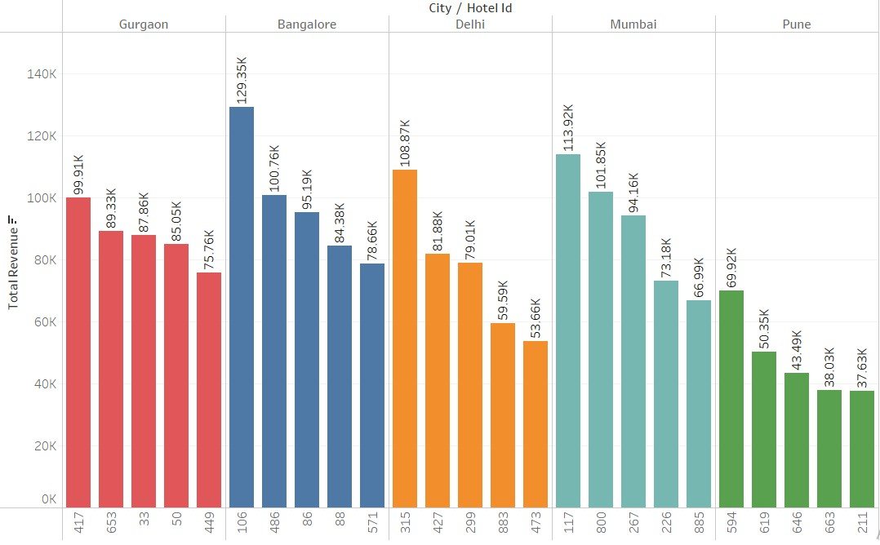
Top 5 Revenue Making Cities Per Top 5 revenue making cities

Slide 14
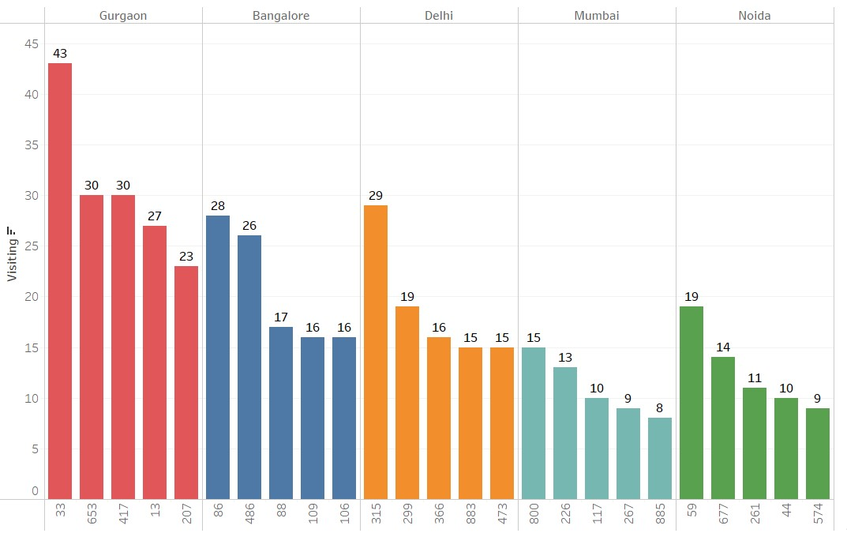
Hotel Performance
Top 5 Visiting Hotels Per Top 5 Visiting Cities

Slide 15
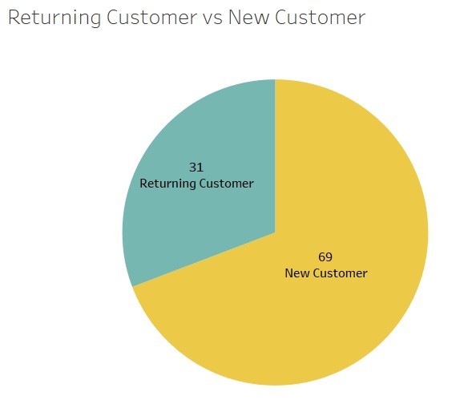
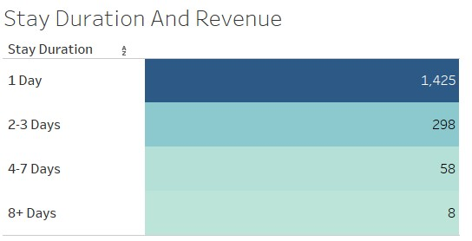
Customer Behaviour
Returning Customer vs New Customer
%
%

Slide 16
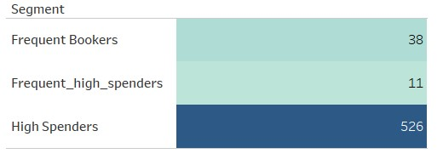
Customer Segmentation

Slide 17
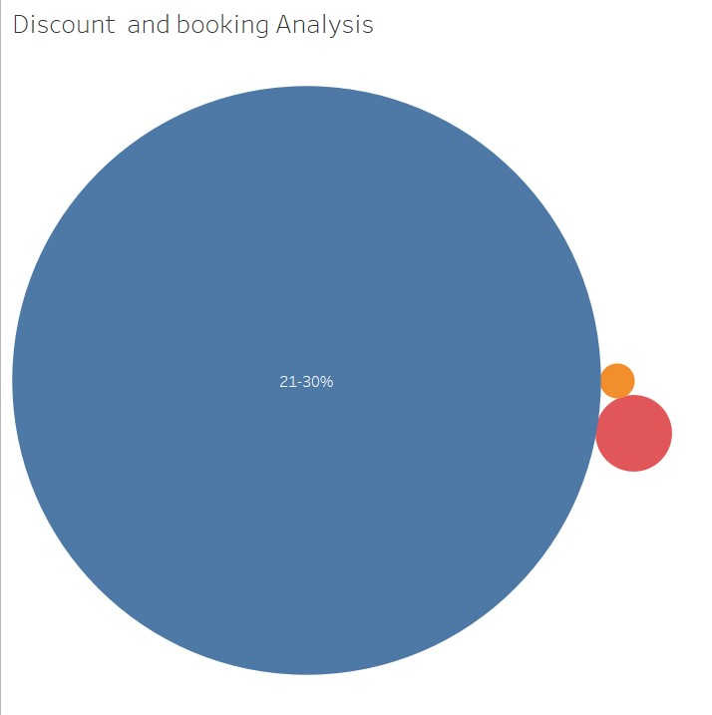

Discount and Booking Analysis

Slide 18
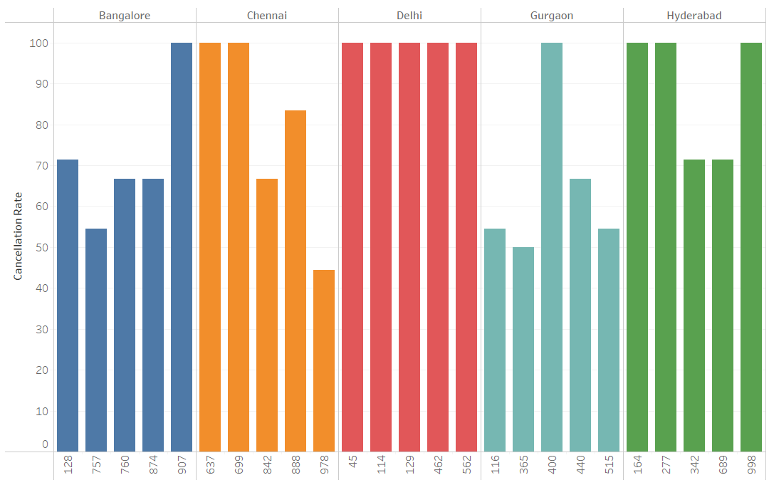
Cancellation Analysis
Highest Cancellation Rate of Hotels Per City

Slide 19
Findings
1
Highest Booking and Highest Revenue Generated in January.
2
Hotel ID 33,162,417,315,13,653,346,207,86 and 77 has the Highest Visitings.
3
Highest Average Revenue Generated City is Mumbai.
4
Top 5 Highest Revenue making cities are Gurgaon, Bangalore, Delhi, Mumbai & Pune.
5
Highest Customer’s Stay Duration is 1 Day.
6
Discount Allowed b/w 20-30 % has counted Highest no. of Bookings.
7
Ratio of Returning and New Customer is 31:69.
8
32.87 % Is an Overall Cancellation Rate.

Slide 20
Suggestions
Reconize and reward loyal customers with exclusive benefits and
personalized offers to increase
retention and satisfaction.
Enhancing Loyalty Programs
Promotional Efforts
Utilize the booking trends to
create targeted marketing
campaigns during peak and
off-peak seasons.
Focus marketing and
promotional efforts on hotels in
Bangalore, Gurgaon, Delhi,
Mumbai, and Noida
Analysis indicates these cities
have the highest customer
visiting rates.
Marketing Campaigns
consider implementing a
discount strategy of 21-30%.
Analysis shows that this
discount range significantly
increases customer bookings.
Discount Optimization

Slide 21
Thanking You

